Slide 1
Veggie Garden Project
By Isabella Crane, Olivia Ipsen & Ellen Granger

Slide 2
Introduction
Group Members: Isabella Crane, Olivia Ipsen and Ellen Granger
Educational Topic: Science
Year Level: Grade 7
Aim of task: The objective of this task is for the students to become more aware and have a better understanding of the healthy food groups and what a healthy diet should consist of. The students will also learn about the process of gardening and the steps involved. This authentic learning task will benefit the students in the future as it is essential to be aware of what a healthy diet consists of.

Slide 3
Teachers Outline: Olivia
I have made a total of seven lessons that the children will complete in order to gain information on authentic learning.
As mentioned before the task is simply growing a veggie patch and taking digital photos off the veggie's progress, then uploading these digital photos to a blog website, called Yola, the children must also add written information.
Each lesson the children are to follow through with the tasks I have given.

Slide 4
Teachers Outline: Olivia
The tasks include something new every week, for example different worksheets or games, but as appose to this the children are to every week take photos to keep on adding to their blog site about their veggie garden.
At the end of seven weeks the children will be able to show all their work to their parents plus their blog site which will be completed will a digital timeline of the growing veggie.
Link to teachers outline page:
http://edn113-2012-groupproject.wikispaces.com/Teachers+Outline

Slide 5
Student Outline : Isabella
On the wiki space, the purpose of the student outline page is to inform the students of the task that they will be presented with and asked to complete
The students will complete the task over a duration of 8 weeks.
On the student outline page there has been a lesson plan set out for each week entailing what will be required of the students during the lesson and the requirements they will need to meet to complete the task.

Slide 6
Student Outline: Isabella
The students have been provided with different forms of resources which will help them throughout the 8 weeks in completing the task
The resources are provided by the teacher, therefore the student simply has to follow the instructions on how to use the resource and will blog about there findings.
Link to student outline:
http://edn113-2012-groupproject.wikispaces.com/Veggie+Garden+Student+Outline

Slide 7
Brief Overview of the task
Our educational topic is science. Within this topic we have created a task for year 7 students to complete. The task is called Veggie Garden Project, this project will consist of the students picking a vegetable to plant each within a group. This will slowly form a veggie patch, the students each need to monitor the process of there veggie gardens via a blog and research about healthy fruit and veggies. As well as reporting on their findings the students will be asked to use different resources to help them with their learning about healthy eating and their particular vegetable they are growing.

Slide 8
Authentic Learning
Growing a vegetable garden and researching about healthy foods and diets link to the real world, as it shows children what is and is not healthy, therefore they will be able to apply this important knowledge in the future.

Slide 9
Resources: ellen
When teaching children in school, it is often the case that the wider range of learning activities - the better! All children learn in different ways so by using many different resources, you (as the teacher) can convey the message to a larger group students.
The next few slides will contain examples and screen shots of the different resources we chose to use for this task.

Slide 10
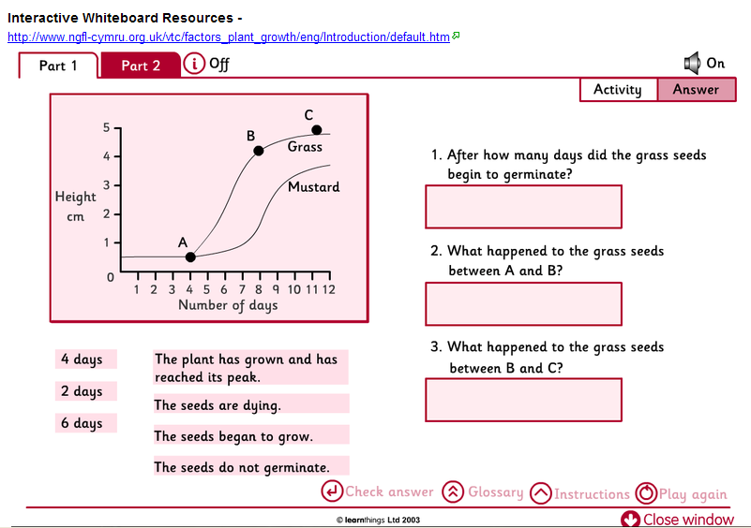
Interactive Whiteboard Resource

Slide 11
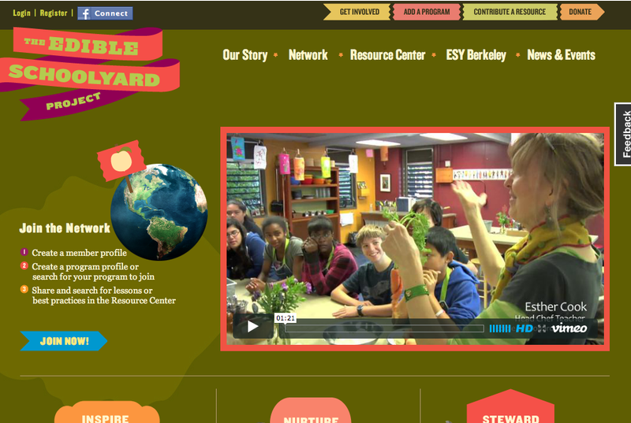
Edible School yard
Edible School Yard is an extremely effective and useful resource both for students and teachers. It give advice on engaging students, allows children to get information on what seeds to plant and when; plus a networking option for classes and individuals.

Slide 12
YouTube
www.youtube.com
This YouTube video entitled "How to Grow a Vegetable Garden" is a step by step tutorial on how to build, position and line your garden bed as well as how to sow the seeds, whether to use seedlings vs. seeds and where to plant the plants in the garden patch. It is age appropriate as well as informative!

Slide 13
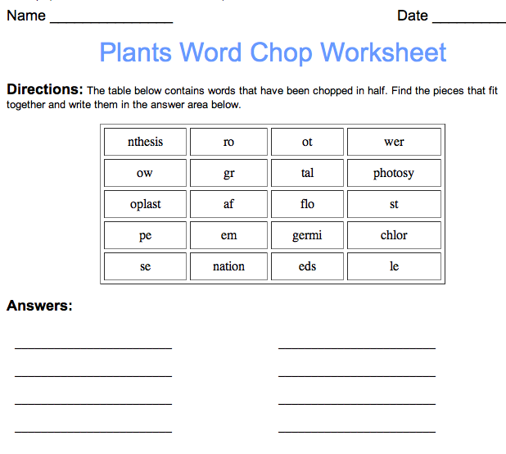
Worksheets

Slide 14
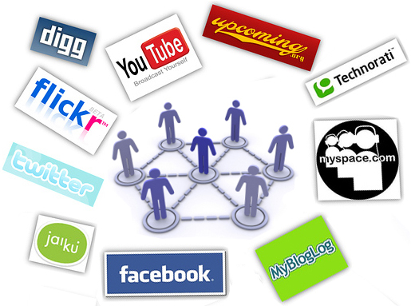
Social Networking Sites
Social Networking sites are useful for student learning as they allow for a group collaboration of researched information plus a discussion area for questions and sharing of ideas and information.
Social networking sites such as Facebook is a great form of communication especially for group work as it allows the whole group to have a conversation and input on their assignment

Slide 15
Thankyou !
If you would like to view our wiki space to gain more information about our task the link is provided below.
http://edn113-2012-groupproject.wikispaces.com/Veggie+Garden+Assignment

